Slide 1
Introduction to Academic Writing

Slide 2
What is academic writing?
Essay, paper, research paper, dissertation, article, lab/business repOrt, etc.;
certain conventions of structure, style and cOntent;
opportunity to investigate an issue and present your position based on the evidence of your research.

Slide 3
How to master academic writing
ask a good question then find answers to it;
discuss and interpret your answers with logic and arguments;
show your understanding and appreciation of your topic and this is what earns you a good grade;
use “precise, impersonal and objective” language;
avoid value judgments and biases;
use formal vocabulary, and references;
avoid judgmental words such as terrible, appalling, fantastic, or incredible;
deal with facts, not assumptions.
Notes:
['baɪəs - тенденция

Slide 4
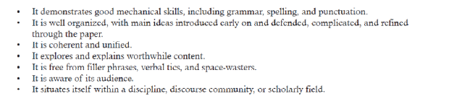
Characteristics of academic writing

Slide 5
The purpose of academic writing
- To report on a piece of research the writer has conducted
- To answer a question the writer has been given or chosen
- To discuss a subject of common interest and give the writer’s view
- To synthesize research done by others on a topic

Slide 6
The structure of academic writing
similar structure;
logical order;
coherence of different parts;

Slide 7
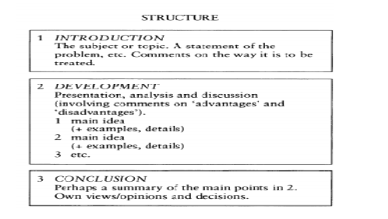

Slide 8
Academic writing process
Rules and practices distinguish academic writing from other forms of writing.
The rules and practices:
formal structure of ideas
referencing and citation techniques
writing mechanics (grammar, punctuation, and spelling) and argumentative and persuasive nature of composition.

Slide 9
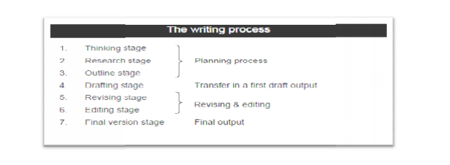

Slide 10
writing is linear;
academic writing is recursive (zigzag process): you switch directions and you backtrack your ideas.
Academic writing is a skill like other skills as driving, painting, and dancing. It gets better through regular practice that leads to proficiency and expertise.

Slide 11
What academic text means?
Academic text is defined as critical, objective, specialized texts written by experts or professionals in a given field using formal language.
Academic texts are objective.
Academic texts often take years to publish because of intense writing and review.

Slide 12
Characteristic of academic text
being formal
studied
researched
objective
exact
direct
has the ability to influence its readers

Slide 13
Examples of Academic Texts
Academic journals:
Scientific journals
Humanities journals

